Slide 1


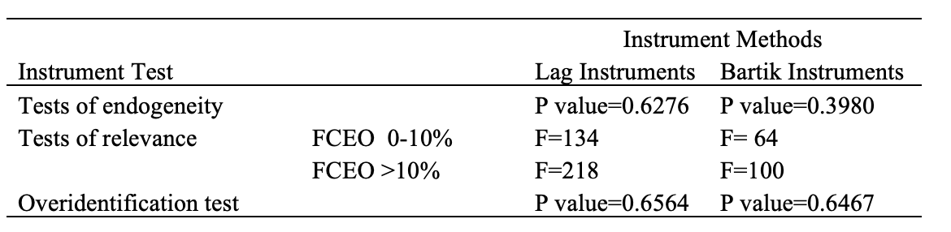
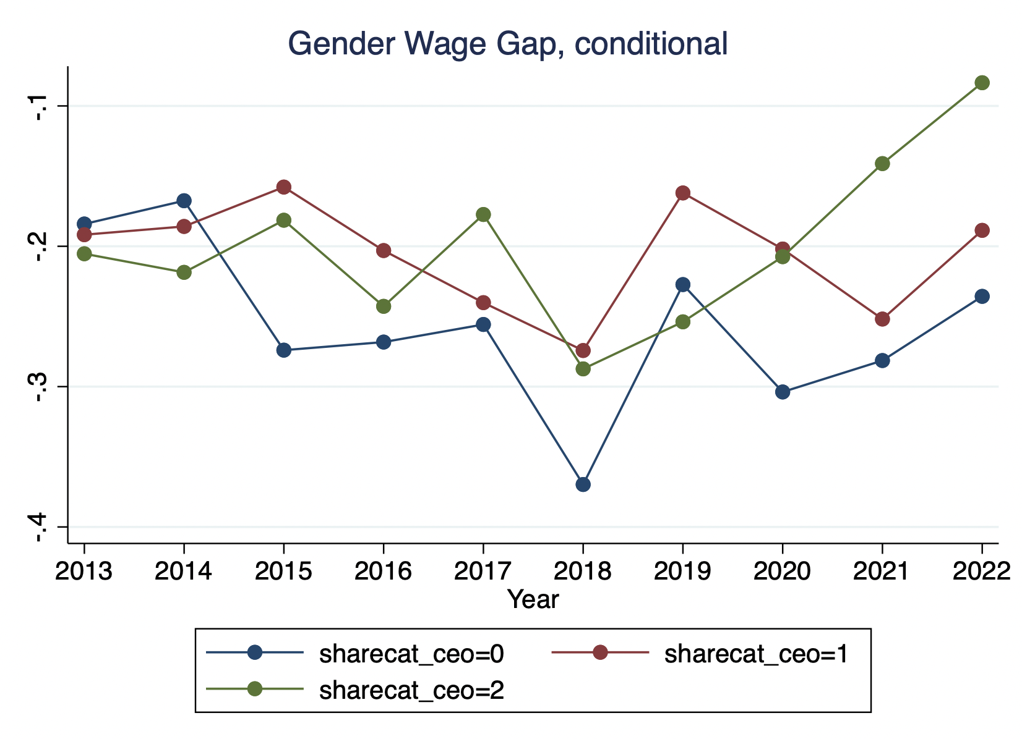
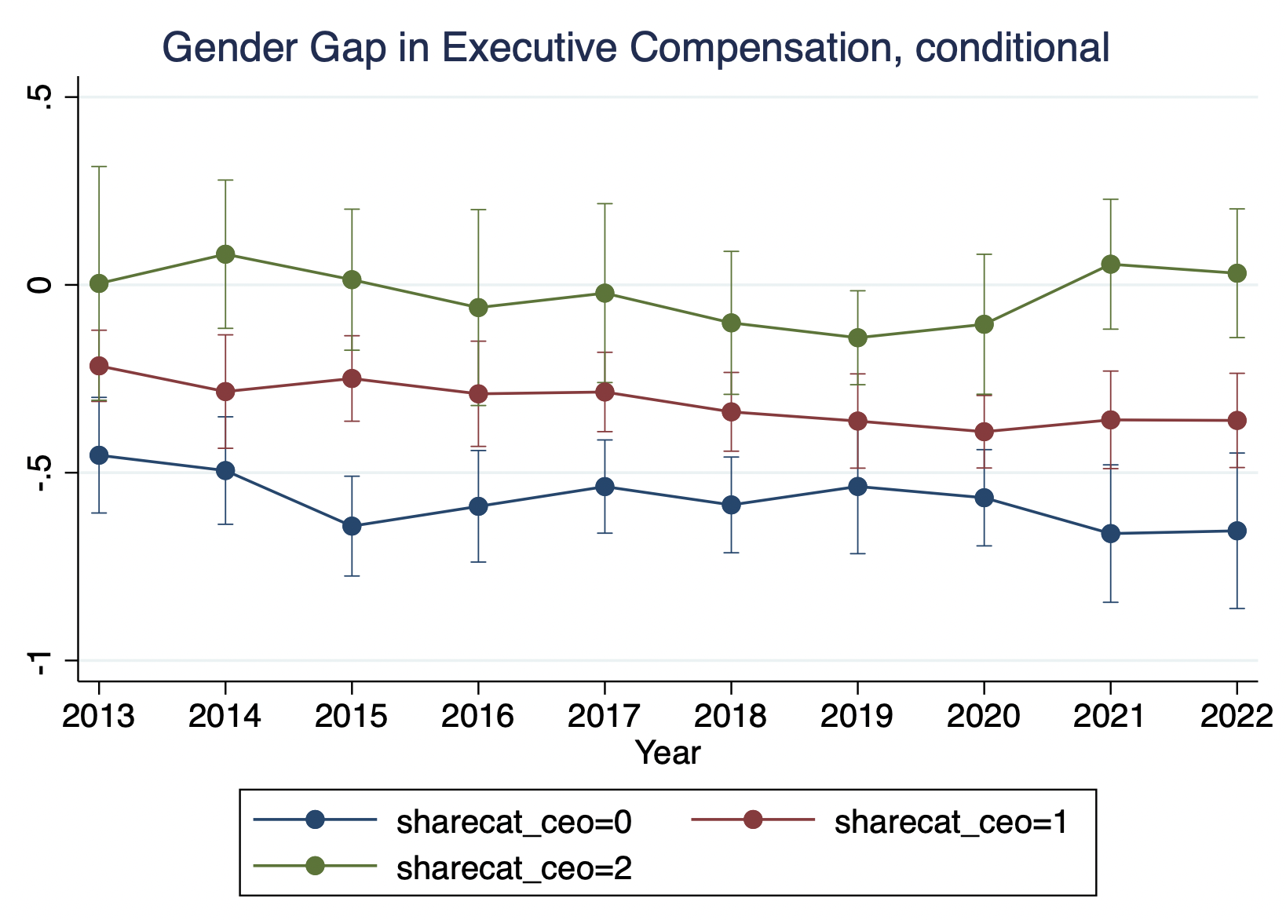
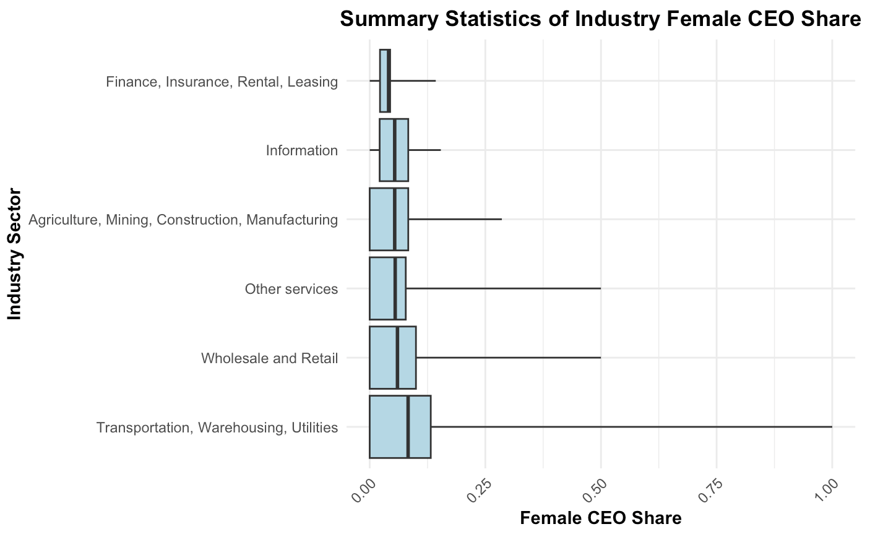
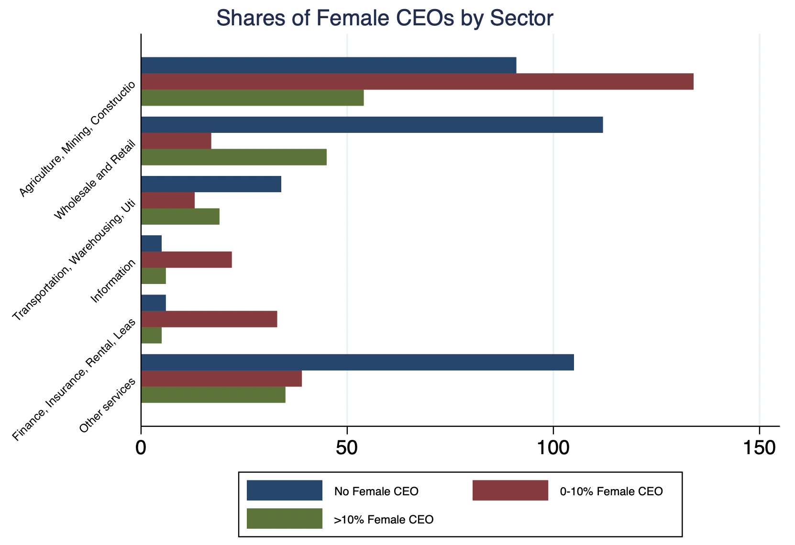

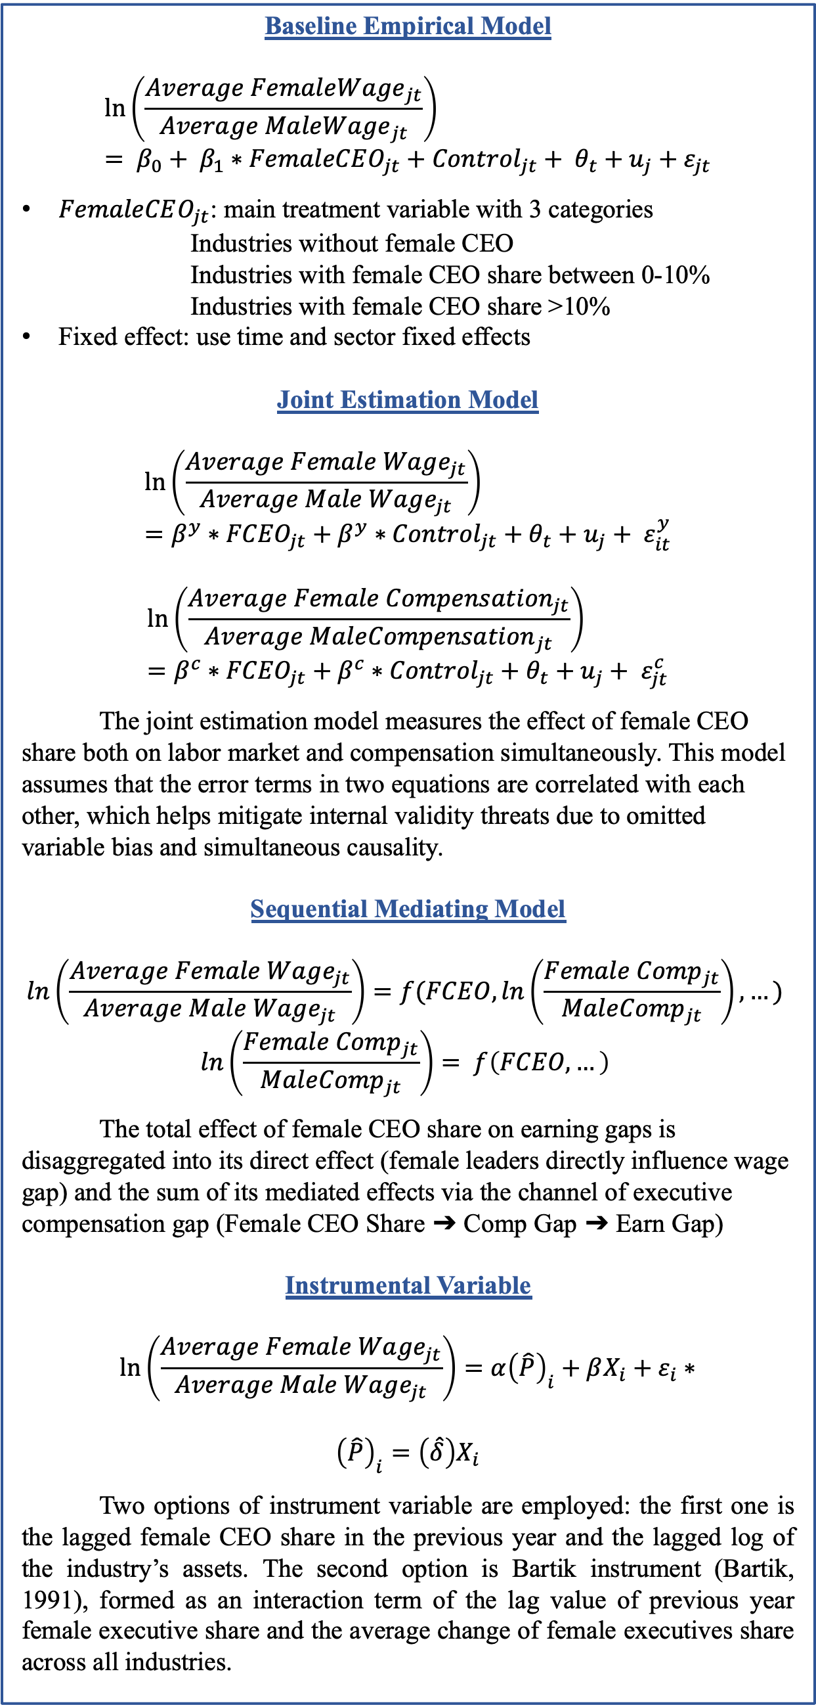
Does Female Management Make a Difference? An Empirical Analysis of Gender Wage Gap
Yiwen Peng
Department of Economics, University of North Carolina at Chapel Hill
Abstract
Labor
Female
Invest
Not Invest
Male
Invest
Not Invest
Female CEO
Male CEO
Female CEO
Male CEO
Female CEO
Male CEO
Female CEO
Male CEO
Empirical Model
Results
Theoretical Model
This research investigates the effect of female leadership representation on gender equality in terms of wages in the corporate sector. It specifically examines the influence of female CEO share on the gender wage gap across various industries. Utilizing data from Executive Composition, Annual Fundamentals, and Current Population Survey, this research employs empirical analysis to examine the directions and levels of influence from female leaders. After implementing baseline OLS, joint estimation, mediating sequential model, and instrumental variables, this research finds that an augmented presence of female CEOs in the corporate sphere will bring more gender equality in terms of labor wages and executive compensations.
Keywords: gender wage gap, workplace equality, female leadership
Exp=p*1-r*h+l2+r*h+1-p*h+l2-c
p
wage=1-r*h+l2+r*h
Baseline Empirical Model
$$\ln\left(\frac{Average Female{Wage}_{jt}}{Average Male{Wage}_{jt}}\right)= β_{0}+ β_{1}∗FemaleCEO_{jt}+Control_{jt}+ θ_{t}+u_{j}+ε_{jt}$$
$FemaleCEO_{jt}$: main treatment variable with 3 categories
Industries without female CEO
Industries with female CEO share between 0-10%
Industries with female CEO share >10%
Fixed effect: use time and sector fixed effects
Joint Estimation Model
$$\ln\left(\frac{Average Female Wage_{jt}}{Average Male Wage_{jt}}\right)=β^{y}∗{FCEO}_{jt}+β^{y}∗{Control}_{jt}+θ_{t}+u_{j}+ ε_{it}^{y}$$
$$\ln\left(\frac{Average Female Compensat{ion}_{jt}}{Average Male{Compensation}_{jt}}\right)=β^{c}∗{FCEO}_{jt}+β^{c}∗{Control}_{jt}+θ_{t}+u_{j}+ ε_{jt}^{c}$$
The joint estimation model measures the effect of female CEO share both on labor market and compensation simultaneously. This model assumes that the error terms in two equations are correlated with each other, which helps mitigate internal validity threats due to omitted variable bias and simultaneous causality.
Sequential Mediating Model
$$\ln\left(\frac{Average Female Wage_{jt}}{Average Male Wage_{jt}}\right)=f(FCEO, \ln\left(\frac{Female Comp_{jt}}{Male{Comp}_{jt}}\right), …)$$
$$ln\left(\frac{Female Comp_{jt}}{Male{Comp}_{jt}}\right)= f\left(FCEO, …\right)$$
The total effect of female CEO share on earning gaps is disaggregated into its direct effect (female leaders directly influence wage gap) and the sum of its mediated effects via the channel of executive compensation gap (Female CEO Share ➔ Comp Gap ➔ Earn Gap)
Instrumental Variable
$$\ln\left(\frac{Average Female Wage_{jt}}{Average Male Wage_{jt}}\right)=α{\left(\hat{P}\right)}_{i}+βX_{i}+ε_{i}∗$$
$${\left(\hat{P}\right)}_{i}=\left(\hat{δ}\right)X_{i}$$
Two options of instrument variable are employed: the first one is the lagged female CEO share in the previous year and the lagged log of the industry’s assets. The second option is Bartik instrument (Bartik, 1991), formed as an interaction term of the lag value of previous year female executive share and the average change of female executives share across all industries.
Table 1: Results for Labor Wage Gap
1-p
Log of Labor Earning Gap | 0-10% Female CEO | >10% Female CEO
OLS | 0.053** (0.024) | 0.060** (0.025)
Joint Estimation | 0.0364 (0.0276) | 0.0461* (0.0268)
Mediating | 0.0584** (0.0259) | 0.0517* (0.0269)
Instrumental - Lag | 0.050 (0.037) | 0.073** (0.032)
Instrumental - Bartik | 0.045 (0.051) | 0.092** (0.040)
wage=h+l2
p
wage=1-r*h+l2+r*l
Exp=p*[1-r*h+l2+r*l]+1-p*h+l2
1-p
wage=h+l2
Exp=1-p*1-r*h+l2+r*h+p*h+l2-c
p
wage=h+l2
Data Description
wage=1-r*h+l2+r*h
The primary datasets used in this research are the Executive Composition, the Current Population Survey (CPS), and Fundamentals Annuals. Executive Composition is an organized firm financial data containing S&P 1500 executive’s compensation, base salary, bonus, and stock option data, collected on a yearly basis from the company’s annual report through Form 10-K and organized by Wharton Research Data Services. Additionally, the CPS as a prominent source of labor force statistics, provides extensive sources of non-managerial worker information, such as wages, demographic information, and working industry. This source is also longitudinal, as about half of the people interviewed this year will be interviewed next year. Fundamentals Annuals organized by Wharton Research Data Services provides a detailed measurement of the S&P 1500 firm’s financial performance, such as its annual revenues, retained earnings, and stocks. This research aggregates the firm’s financial and executive data into the industry level and merges it with employee-side data from CPS.
The major outcome variables are the labor earning gap and executive’s average compensation gap in each industry, which is derived by taking the average of male and female wages and then calculating their log of difference. The industry is classified according to the 2-digit CPS industry code, with six overarching industry sectors.
The main treatment variable is the female CEO’s representation in each industry, calculated by dividing the female CEO’s number by the total number of CEOs.
1-p
Table 2: Results for Executive Compensation Gap
p
wage=h+l2
Log of Executive Compensation Gap | OLS | Joint Estimation | Mediating
0-10% Female CEO | 0.268*** (0.036) | 0.275*** (0.0493) | 0.268*** (0.0318)
>10% Female CEO | 0.549*** (0.038) | 0.559*** (0.0719) | 0.549*** (0.0394)
Exp=(1-p)*[1-r*h+l2+r*l]+p*h+l2
1-p
wage=1-r*h+l2+r*l
The Statistical Discrimination Model with human capital accumulation addresses the mechanism of how female leadership influences labor’s human capital investment decision and finally leads to gaps in individual productivity and gender wage gap.
There are two major periods: in period 1, individual labor determines their human capital investment, and in period 2, individual labor enters the labor markets, and their employer decides their wages. The punchline is that one individual’s wage is determined by his or her productivity, the average productivity of the belonging labor group, and the percussiveness of signaling of his or her employer.
This adopted framework captures the dynamic nature of investment decisions up to the point of employee entering the labor market. The larger share of female CEOs will make female labor more willing to invest in human capital and therefore obtain higher wages after they enter the labor market.
The positive sign on coefficient indicates either females earn more or males earn less, suggesting a smaller wage gap between genders.
Robust standard errors in parentheses *** p<0.01, ** p<0.05, * p<0.1.
Table 3: Test Results for Instrumental Variable
Conclusion
The empirical analysis points to the conclusion that an augmented presence of female CEOs in the corporate sphere help (a) narrow the compensation gap among executive echelons, and (b) diminish the earnings disparities faced by non-managerial labor due to gender. This finding underscores the policy implication of advocating for gender-balanced leadership as a means to foster equitable wage practices across the corporate landscape.
Figure 1: Trend of Outcome Variable
Figure 2: Treatment Variable by Industry Sector
Key References
Flabbi, Luca, and Andrea Moro. “The Effect of Job Flexibility on Female Labor Market Outcomes: Estimates from a Search and Bargaining Model.” Journal of Econometrics, 2010.
Goldin, Claudia. “The Quiet Revolution That Transformed Women’s Employment, Education, and Family.” American Economic Review, vol. 96, no. 2, May 2006, pp. 1–21.
Contact: Yiwen Peng (peng.ywflora@gmail.com)
Thesis Advisor: Dr. Luca Flabbi
Faculty Advisor: Dr. Klara Peter

